Slide 1
Capture the Right Data to Enable Real Improvement
From Process-Driven to Data-Driven
German Chung
9 January 2026

Slide 2
Opening Challenge
How do we squeeze building a floor from 6 days into 5?
Full sequence of steps?
Who does what?
When each step starts/ends?
What deliverables?
How to validate the step end?
Dependencies between steps?

Slide 3
You don’t know what you don’t know
What?
Users tell you their pain point, not the whole process
Users only see their own part of the workflow
No one describes the end‑to‑end process
You only hear symptoms, not the full system
Missing context = missing bottlenecks
Key message:
Pain points are local.
Processes are end‑to‑end.
Data required – what step needed
Data generated – what step produced
Data required + data generated = the full truth.

Slide 4
Process-Driven vs Data-Driven
Process-Driven
Pain-Point Thinking
SME complains
Analyst documents
Analyst streamlines
No real improvement
Process pain point ≠ root cause
Data-Driven
Ask: What data explains the delay?
Required data → what the step needs
Generated data → what the step produces
Without both, you cannot analyze
Without analysis, you cannot improve

Slide 5
Focus Area
Material Acquisition
Engineer Assignment
Work Execution
QA
Delivery
Tender
Define a target state of each stage

Slide 6
Define ‘Good’
Faster time-to-market?
Lower cost?
Root Cause
Fishbone analysis
Dimensions – Parties, systems, data
Map with Data
Data needed to perform the step
Data generated in the step
Identify Gaps
No data collect? Data not validated?
System missed? People not record / data exist but not used?
Prioritization
Effort
Impact
Define Actions
Goal
Deliverables
Plan Collaboration
Importance of goal
Importance of relationship
Action Plan
Organization chart
Gantt chart
Implement and monitor
Current status with RGB
Next status with RGB

Slide 7
Define ‘Good’
What is the target looks like?
🚀 Faster time-to-market
💰 Lower cost
✅Higher quality
⏱️ Fewer delays
🏛️ Strengthened governance

Slide 8
Root Cause Analysis
Materials
Parts
raw materials
Machinery
Equipment
Software / systems
Methods
Procedure documents
Techniques / certifications
Regulation standards
Target State
Measurement
Key indicators
Measurement devices
Key data captures
Manpower
Engineers
Suppliers
Training / skill / competence
Mother Nature
Environment
Externalities

Slide 9
Maps with Data
Data needed | Data Generated | What ‘Good’
What data is needed? Identify the data must exist before this step can start | Where will the data be stored? Identify the system or repository will hold the output data | 🚀 Faster time‑to‑market Less waiting Fewer handover delays
Where is the data located? Locate the system, file, or person currently holds this data | Who owns the generated data? Identify the team is responsible for maintaining and updating it | 💰 Lower cost Less rework, fewer errors, better planning Continuous improvement Data supports long‑term optimization
Who owns the data? Identify the data owner | What is the data format? The structure must the data follow (date, numeric, text, dropdown) | ✅ Higher quality Consistent, validated, reliable information Automated reporting Less manual work, more insight
Is approval required? Seek for approval from data owner for the data access. | What are the data boundaries? The acceptable ranges, mandatory fields, or limits | ⏱️ Fewer delays Real bottleneck identification Data reveals the true constraint Accurate forecasting Better resource and timeline predictions
Is approval documented? The approval must be recorded, timestamped and traceable. If the access include time constraint, make sure the data access within the time constraint or obtain extension before the deadline | What validation rules apply? Ensure the data is complete, correct, and timely -> data quality | 🏛️ Strengthened Governance Clear accountability Ownership is visible and enforced
What is the data format? The structure must the data follow (date, numeric, text, dropdown) | Who can access the data? Role based access / need to know basis

Slide 10
Gap Analysis – what looks for?
Gap Type | Explanation | Impact
No data collected | The required data is not captured anywhere | Cannot measure delay
Data not validated | Data is captured but inaccurate or inconsistent | Wrong analysis, misleading insights
System missed | System lacks fields or logic to capture needed data | Blind spots in root cause analysis
People not recording | Users skip or ignore data entry | Data gaps, unreliable reporting
Data exists but not used | Data is captured but not analyzed | No improvement, repeated issues

Slide 11
Prioritization – Effort vs Impact Matrix
High
Effort
High Effort + Low Impact
Avoid 👎
High Effort + High Impact
Plan Later 🤔
Impact
Low Effort + Low Impact
Optional👌
Low Effort + High Impact
Do First 👍
Low
High

Slide 12
Define Actions
Goal to Achieve
Identify the organizational goal the solution aims to achieve
Answer the question ‘Why are we doing this?’
Parties Involved
Identify sponsor, stakeholder, implementer, validator, BAU
Answer the question ‘Who can influence what achievements towards to the goal?’
Cost Incurred
Identify cost incurred, e.g. staff cost, vendor cost, resources cost
Answer the question ‘What are the cost incurred and who pay for them?‘
Impact
Identify each parties involvement
Answer the question ‘What will each party participate inside, during implementation and post implementation process?’
Deliverables
Document the deliverables, including the action deliverables and post-implementation BAU processes
Answer the question ‘How will each party do in contribution to deliverables, including implementation deliverables and operational deliverables?’
Success Criteria
Document the acceptance of each deliverables and its corresponding quality check
Answer the question ‘What are the acceptance criteria of each deliverables, and how to measure?’

Slide 13
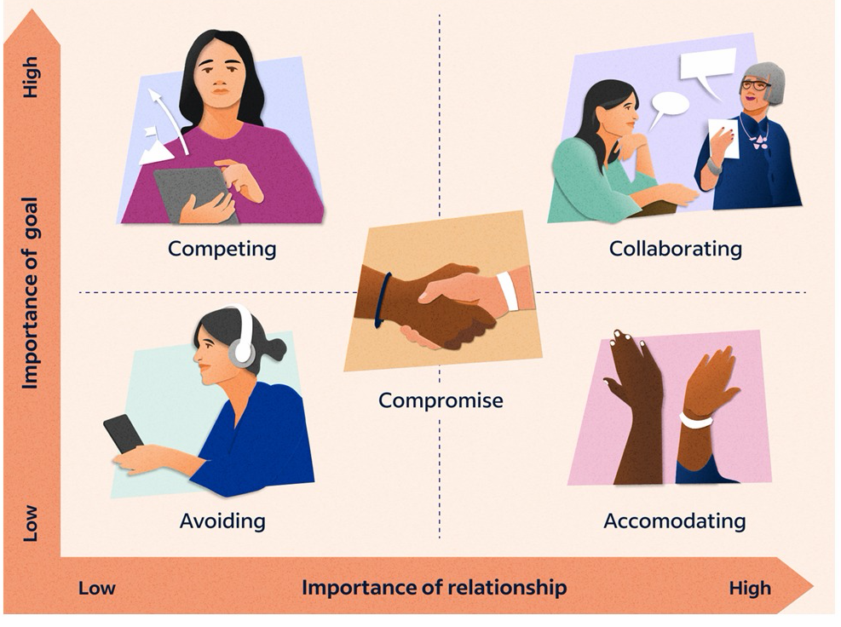
Plan Collaboration

Slide 14
Organization Chart
Business
IT
Sponsor (VP / CxO)
Sponsor (CTO)
Stakeholder (Head of / Director)
Project Manager
Stakeholder (Head of / Director)
Business Analyst
Process Owner
Tester / Validator
Implementer

Slide 15
Gantt Chart (8 Weeks Style)
Week 1 | Week 2 | Week 3 | Week 4 | Week 5 | Week 6 | Week 7 | Week 8
Identify Goal and its parties involved, deliverables and requirements | Define acceptance criteria, implement. |  | Deliverable testing / validation |  | Fixing | Re-test. Documents and document validations | Delivery, validation and sign off
 | Status monitoring and reporting
Process Owner
PM
BA
Tester / Validator
Implementer

Slide 16
One-page Status Report
On-track
Risk but manageable(<10%)
Critical (>=10%)
Overall Status – Overall status till the end of implementation is (color).
One-sentence ’Area (schedule / cost / resources) of risk / critical cause the status.’
One-sentence ‘Potential impact (schedule delay / cost increase / more resources required).’
One-sentence ‘Mitigation / risk migration (details of how long to delay, how much cost needed, how many additional resources required for what purpose)’
One-sentence ‘Decision / Seek for approval’
Schedule Status – Current status is (color). Next status is (color)
One-sentence ’Cause of the status.’
One-sentence ‘Potential impact.’
One-sentence ‘Mitigation / risk migration’
One-sentence ‘Decision / Seek for approval’
Cost Status – Current status is (color). Next Status is (color)
One-sentence ’Cause of the status.’
One-sentence ‘Potential impact.’
One-sentence ‘Mitigation / risk migration’
One-sentence ‘Decision / Seek for approval’
Resources Status – Current status is (color). Next Status is (color)
One-sentence ’Cause of the status.’
One-sentence ‘Potential impact.’
One-sentence ‘Mitigation / risk migration’
One-sentence ‘Decision / Seek for approval’

